Slide 1
Battle of Neighborhood: Classification of Metro Stations of Bengaluru and Identifying for the business opportunities
IBM Data Science Capstone Project

Slide 2
Introduction
Bangalore metro known as “ Namma Metro “ which translates into English as ‘ Our Metro’ is a rapid transit system serving the city of Bangalore, India.
It is the fourth longest operational metro network in India after the Delhi Metro, Hyderabad Metro and Chennai Metro.
By 2023, the system is expected to complete its phase 2 network and provide connectivity to the city's important tech hubs of Electronic City and Whitefield.

Slide 3
Problem Statement
Business opportunities of the around the metro stations is very attractive. It attracts large sets of people as it is commute.
So for the business is around the metro station will be profitable. But having the same type of business around the metro station will leads to competitive market. As competition grows the profits will eventually less.
This project mainly focuses on what kind of the businesses which are currently existing around the existing as well as upcoming metro stations and clustering to identify the gaps in the market.
By considering the metro stations which are still in construction phase we can plan the for business which are currently nor existing around those metro stations.

Slide 4
Target Audience
Current project will be useful for the entrepreneurs who are looking for business opportunities in Bengaluru city.
Useful to the construction builders of the localities of the metro stations, so that they can estimate their future real estate values.

Slide 5
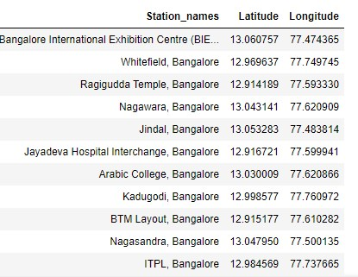
Data
Data of all the existing metro stations as well as the upcoming metro stations. The data should consists of the Station name, Co-ordinates.
But unfortunately there no websites which directly give this information. So the data scrapping is the only solution.

Slide 6
Methodology
Fetching data from Foursquare
Exploratory Data analysis
K Means Clustering

Slide 7
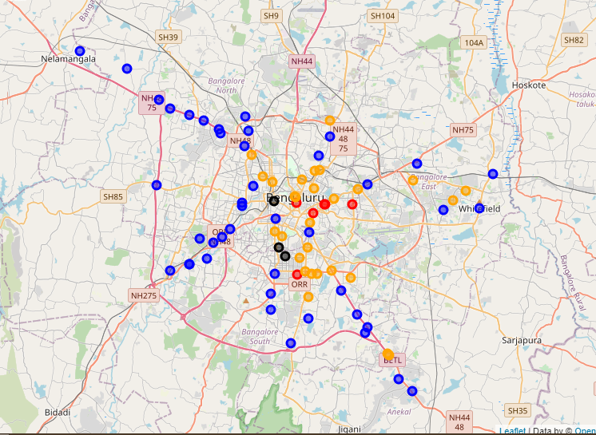
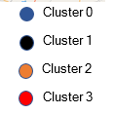
Results
Cluster 0: Under Developed zones
Cluster 1: Entertainment and Recreation Dominated zones
Cluster 2: Professional dominated zones
Cluster 3: Developed zones with proper distribution of venues.

Slide 8
Discussion and Conclusion
Foursquare data regarding Bangalore city is very limited. It definitely affect the results in cluster. Considering the accuracy of foursquare data, many cluster usually dominated by one to two categories. Hence there will be ample amount of scope to start new business where the competition will be very less.
In underdeveloped region the venues are very less in number, so starting the professional organization in that area will indirectly affects the other venues also.
An entruepuner can analyze the results he can choose the appropriate location for his business plan.
The property builders can identify the future lacking of the buildings which will be suited to certain business and they can come up with planning a construction in that area.

